Slide 1
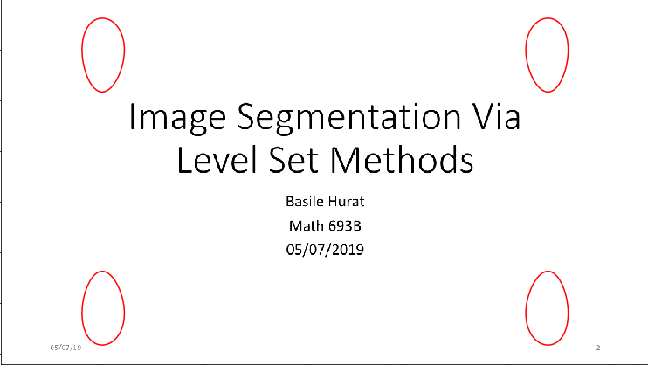
Image Segmentation Via Level Set Methods
Basile Hurat
Math 693B
05/07/2019

Slide 2
Outline
Why do Image Segmentation?
Introduction to Front Propagation
The Level Set Method
Numerical Implementation
Gradient Based Method And The Upwind Scheme
Region Based Method And The Lax Friedrichs Flux Scheme (If Time)
Conclusion

Slide 3
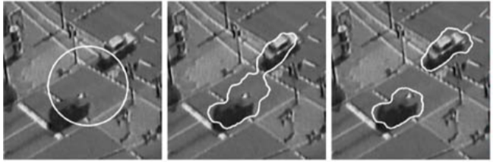
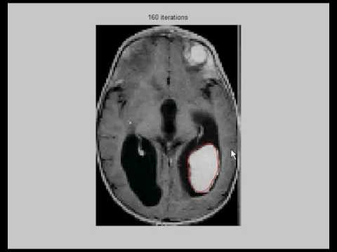
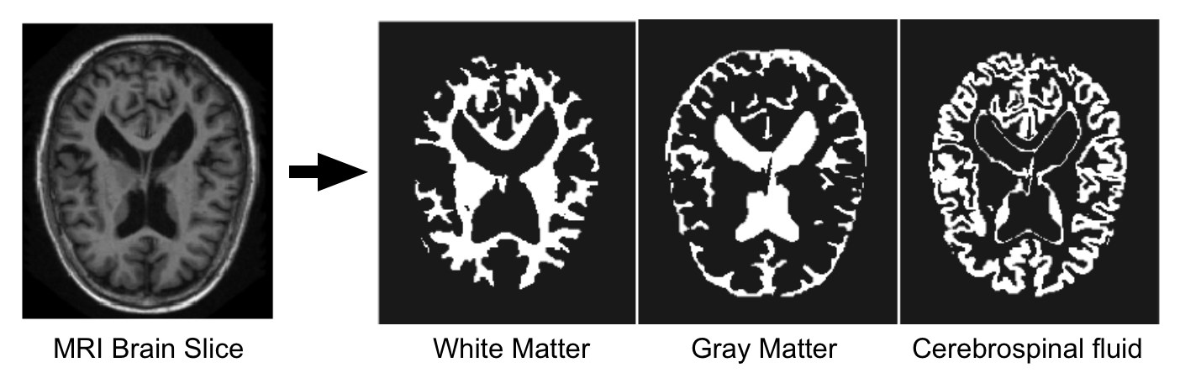
Why Do Image Segmentation?
Object Detection & Computer Vision
Medical Imaging
Selective Processing

Slide 4
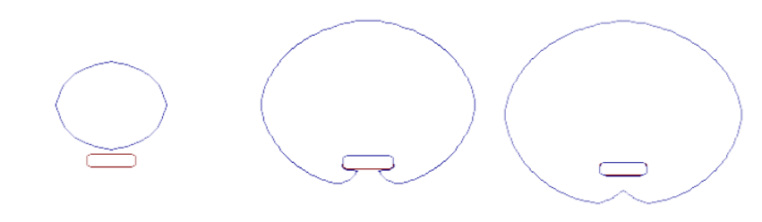
Image Segmentation Via Front Propagation
The Concept: Propagate a front such that velocity is 0 at obstacles and 1 otherwise
Initial contour
Stopped by an obstacle
Later perturbation

Slide 5
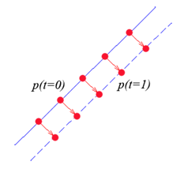
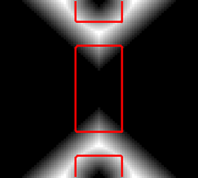
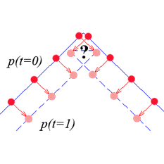
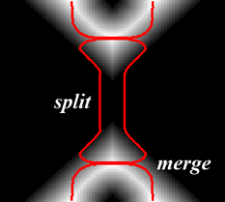
Explicit Front Propagation
What if we define front explicitly with a function?
While simple at first, there are two major issues:
Corner issues
Topology issues

Slide 6
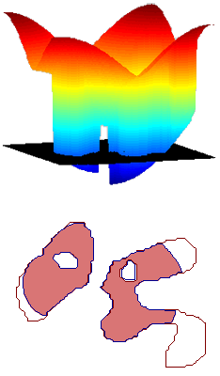
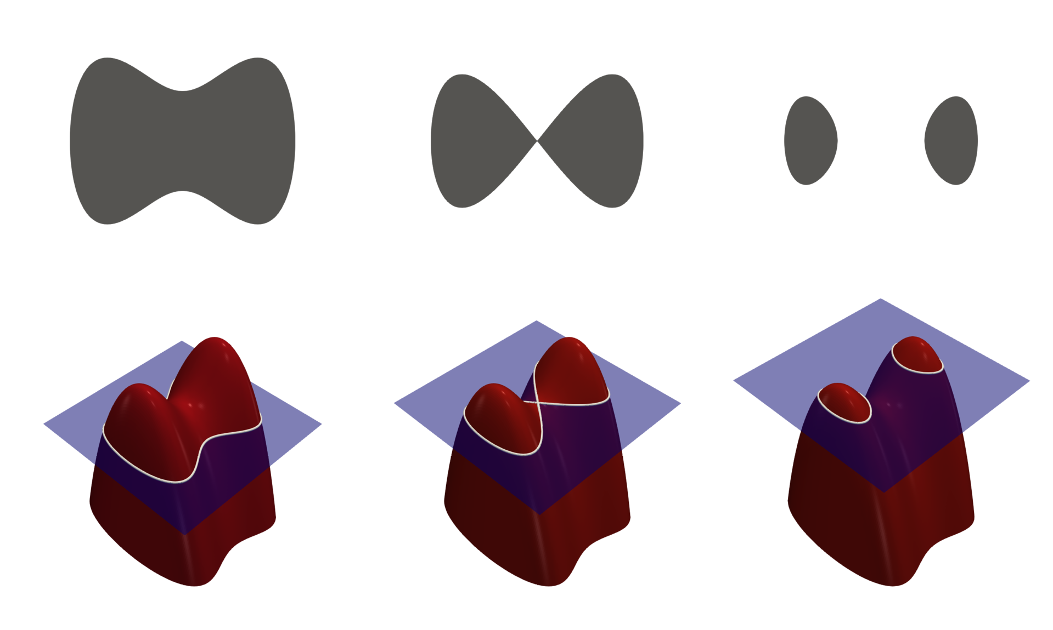
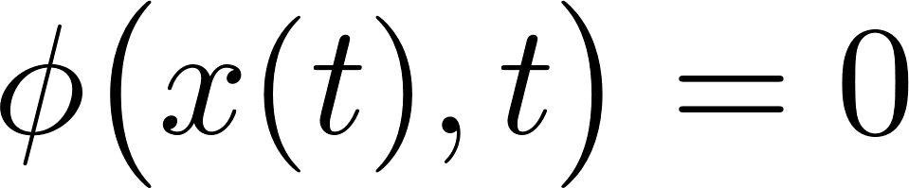
Implicit Front Propagation - Level Sets
Rather than explicitly defining front, implicitly define it as the intersection between a surface and plane
Level Set is defined by:
Benefit: Topology problem is gone
This method evolves surface through time as PDE.

Slide 7
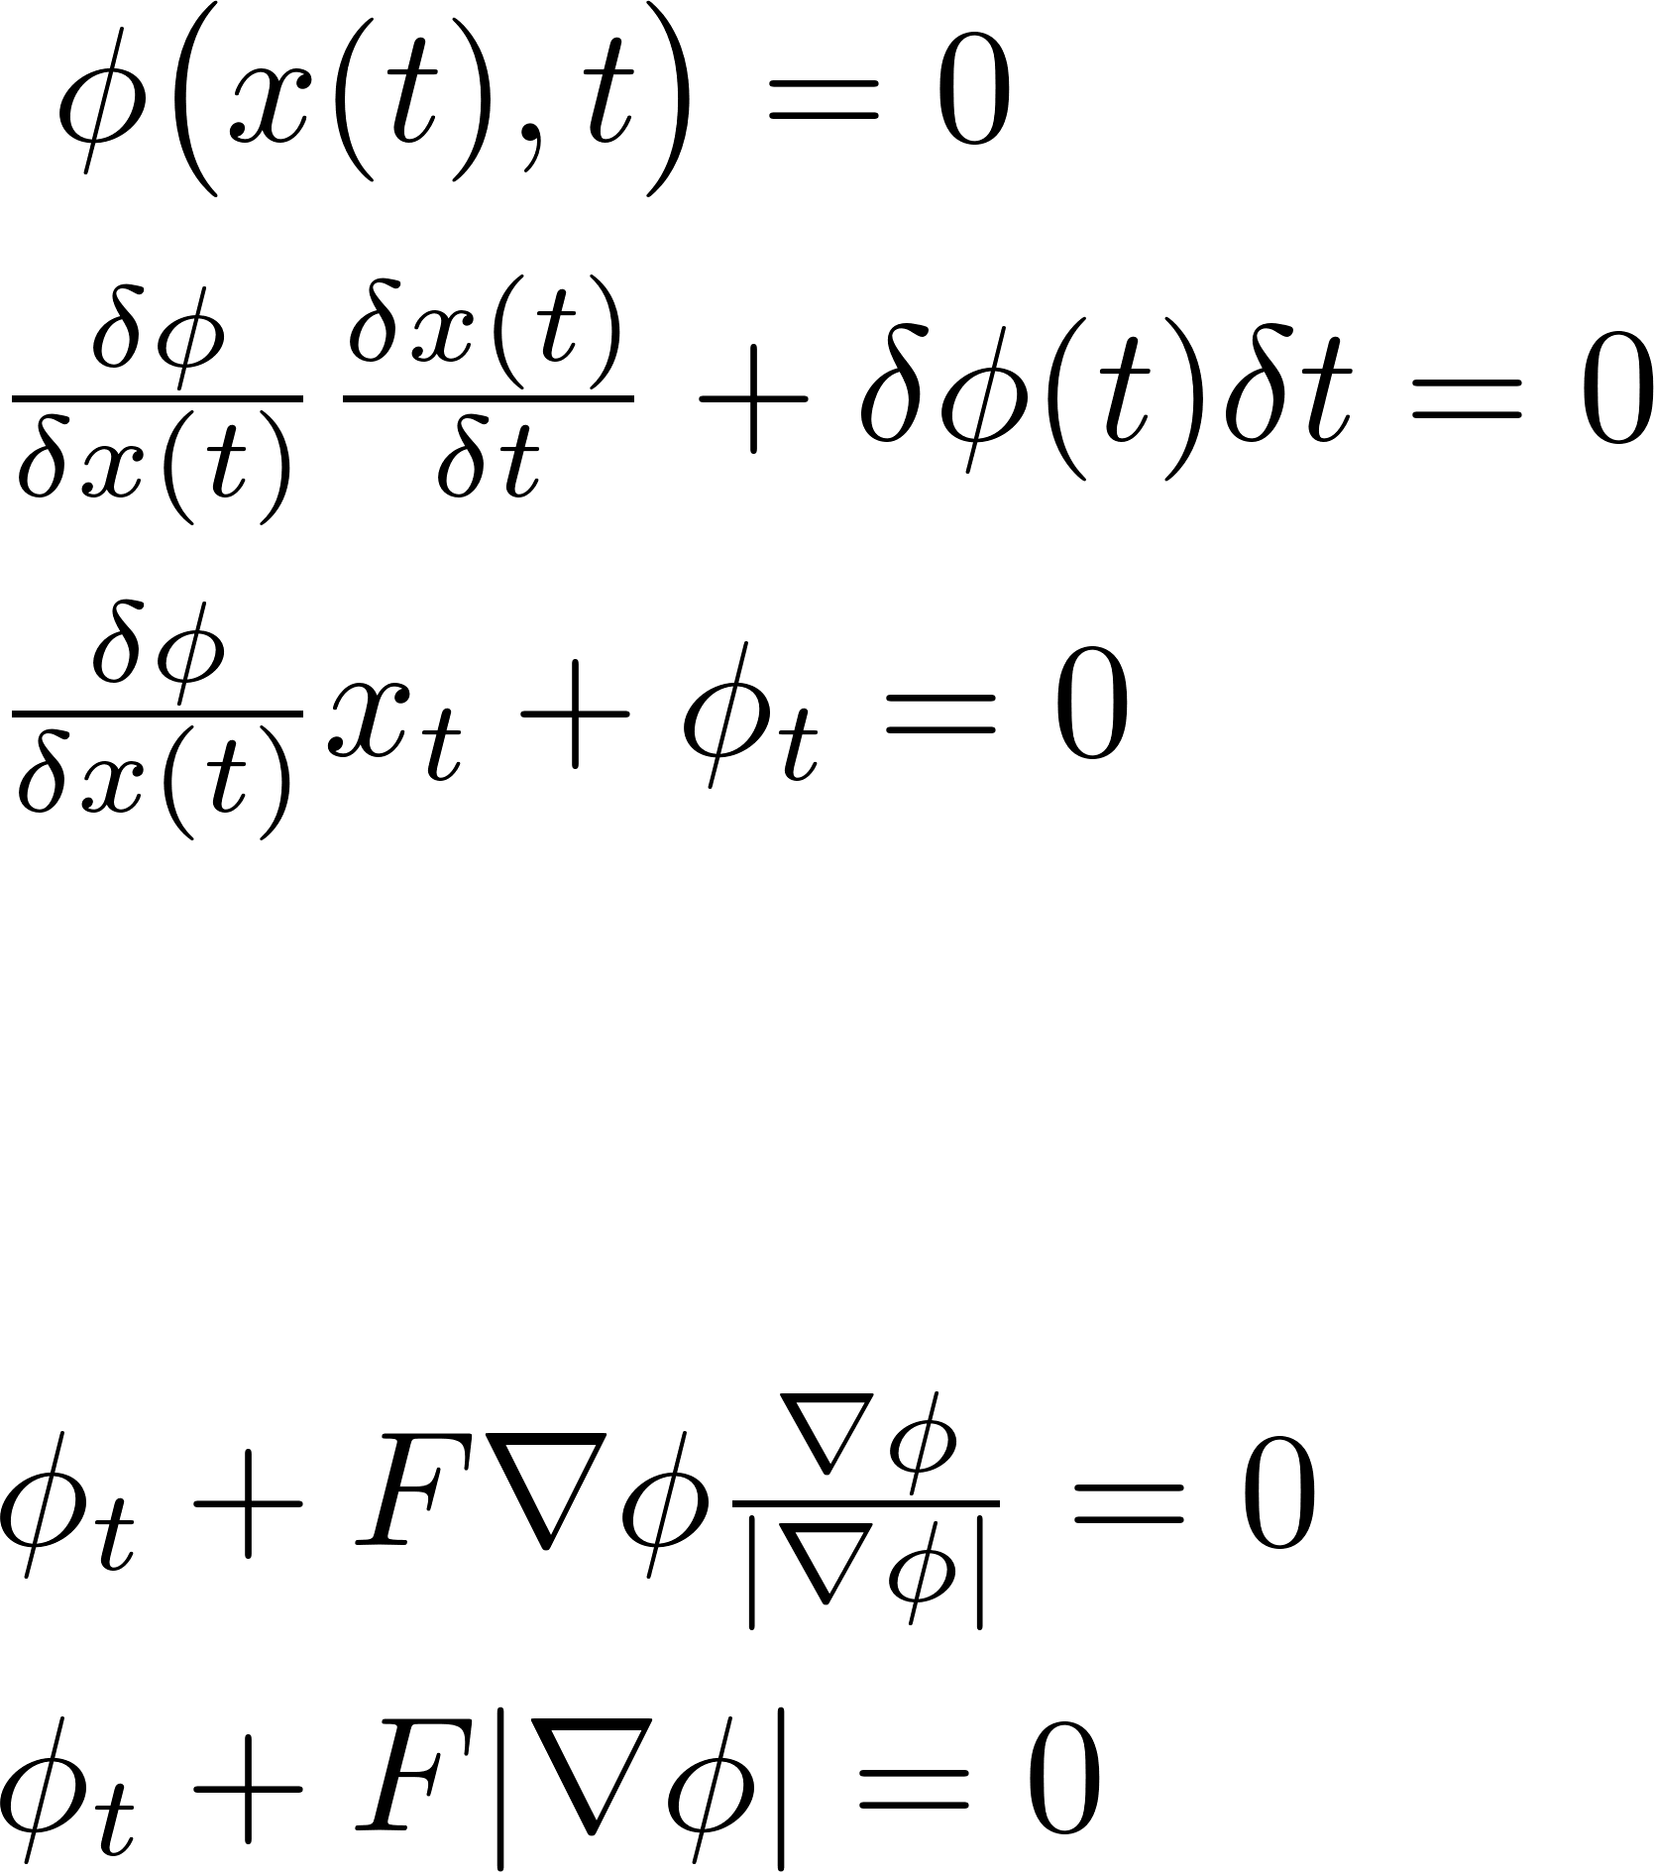
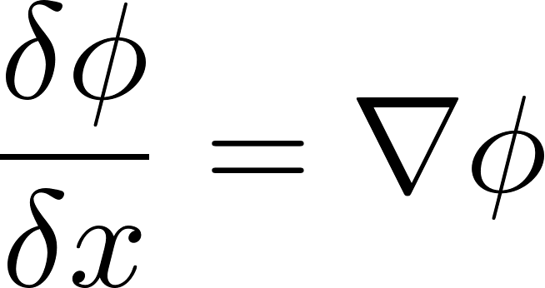

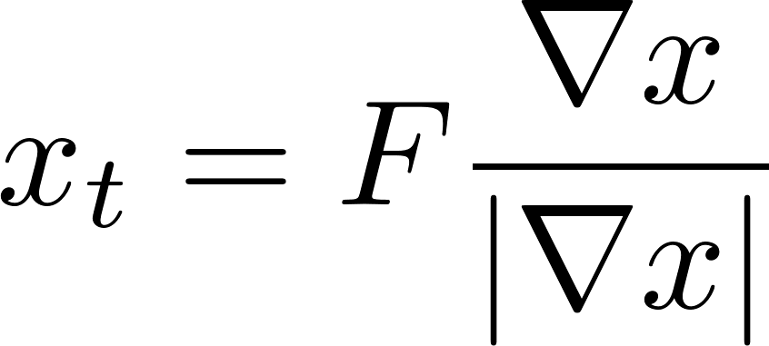

Level Set Method - Deriving The PDE
But and is given by a force normal to the surface, which means , where is our velocity term. Thus, we have

Slide 8
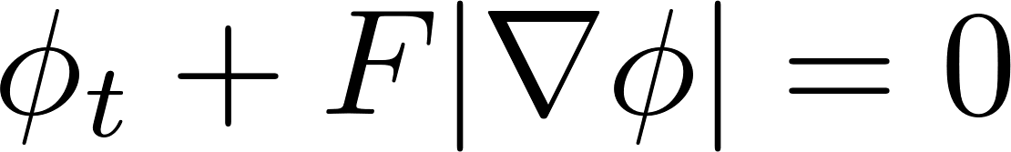
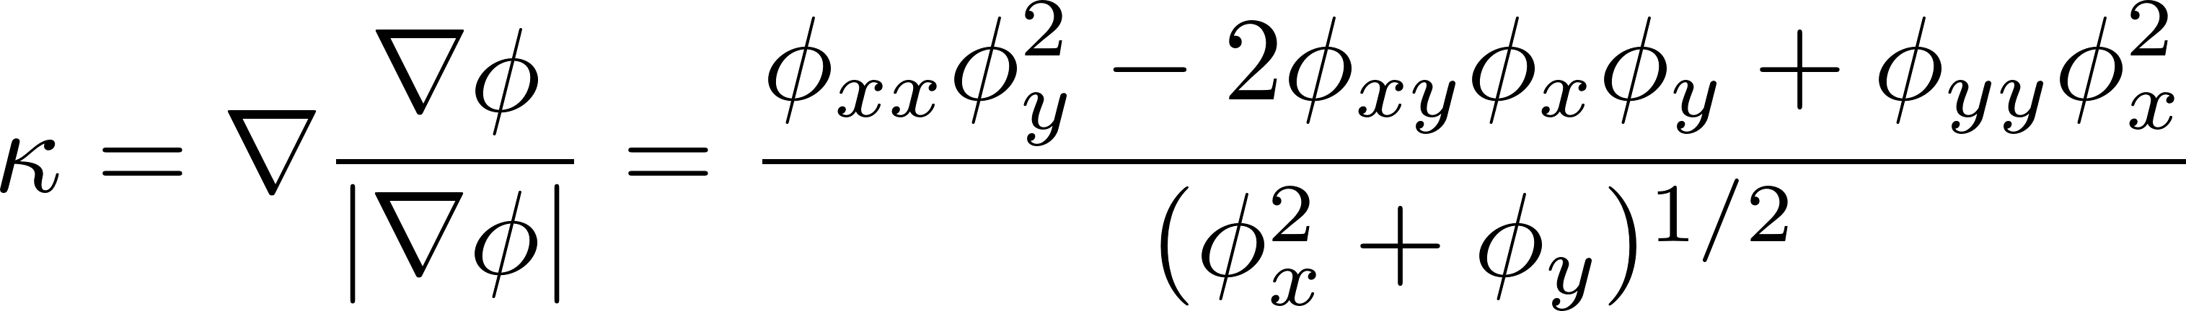
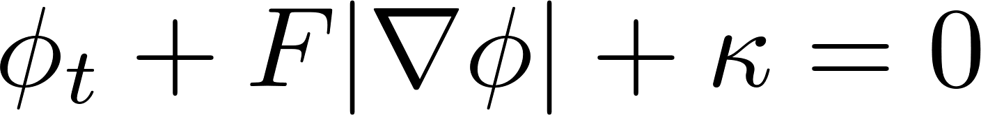
Level Set Method – A Closer Look
Our Equation:
We can take advantage of the geometry of surfaces by adding a curvature term to guarantee smoother fronts:
Equation becomes:
In our application, the velocity forcing term F is defined by our image

Slide 9
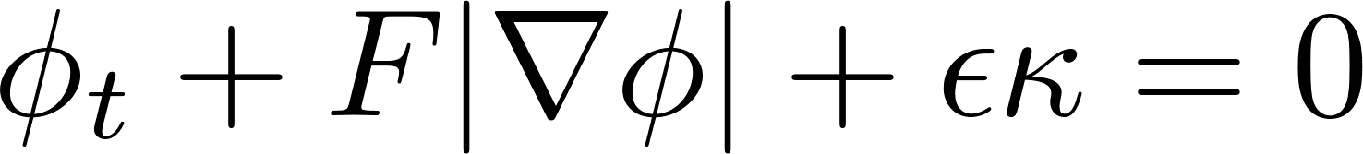
Level Sets – Numerical Obstacles
The forcing term might change sign!
-> Resolved with upwind scheme
Also, there’s a nonlinear term!
-> Resolved with upwind scheme [5]
Unfortunately, two overlapping upwind schemes break
So we have two options:
Make the forcing term non-negative OR
Find another scheme for nonlinear term

Slide 10
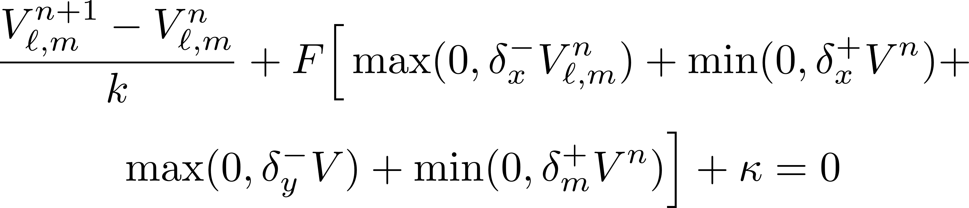
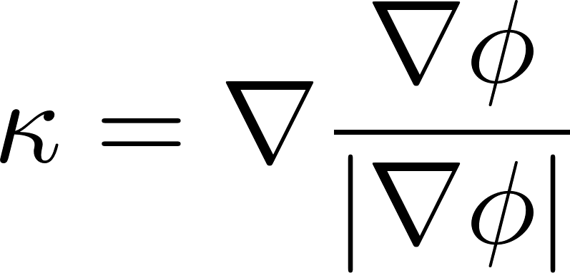

The Scheme – Upwind Method
Where is calculated using Upwind schemes.
Another acceptable choice for calculating could be using central differences.

Slide 11


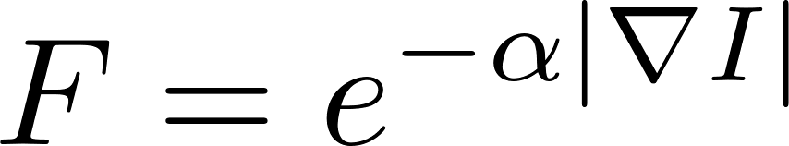


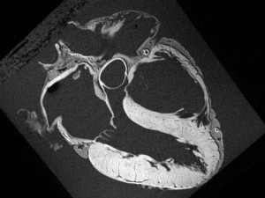
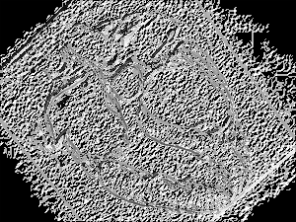
Forcing Functions - Gradient Based
Gradient comparison is a straightforward way to perform edge detection
Equation:
Benefits:
Strictly positive – Upwind works
Simple
Drawbacks:
Weak edges (common with noise) can cause leaking (pre-processing can help)
Initial condition dependent

Slide 12
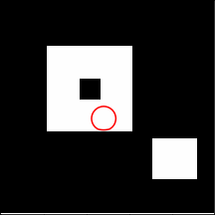
Gradient-Based Segmentation: Results
No noise

Slide 13
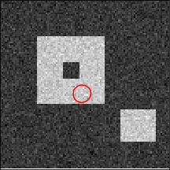

Gradient-Based Segmentation: Results
Added noise
leads to bleeding contour

Slide 14
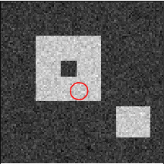
Gradient-Based Segmentation: Results
Noise again
Added gaussian blurring
No bleeding!

Slide 15
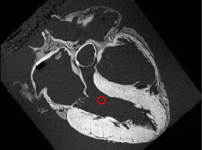
Gradient Based Level Set – Real World Application

Slide 16


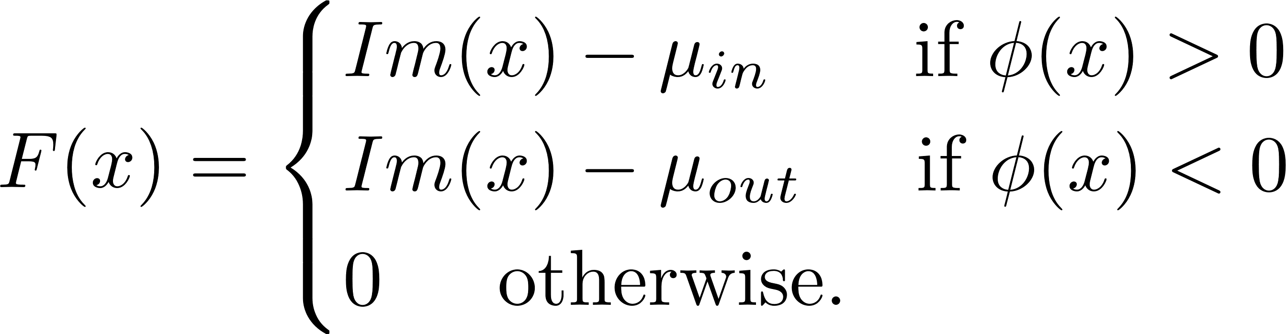
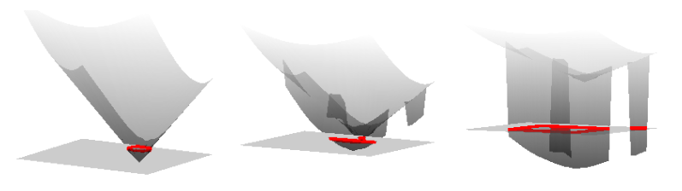
Forcing Functions - Region Based
What’s the benefit of allowing a negative forcing term? Not IC dependent!
Level Set method naturally defines two regions: Inside contour ( )
and outside contour( )
Measure homogeneity of region
Equation:
Benefits:
Segments all regions at once
Better behaved with noise
Not IC dependent
Drawbacks:
Can be negative -> Upwind will not work

Slide 17
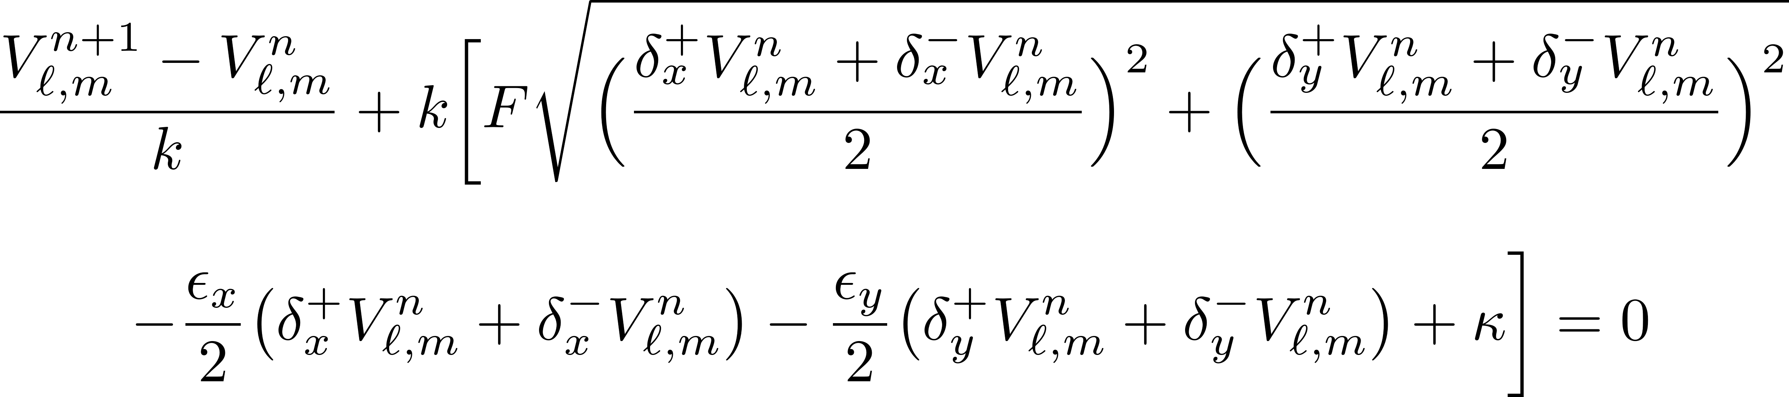
Region Based – Lax Friedrichs Flux Scheme

Slide 18

Region-Based Segmentation: Results
Starting inside shape

Slide 19
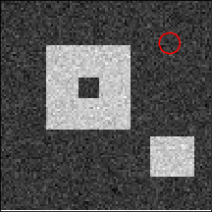
Region-Based Segmentation: Results
Starting outside shape

Slide 20
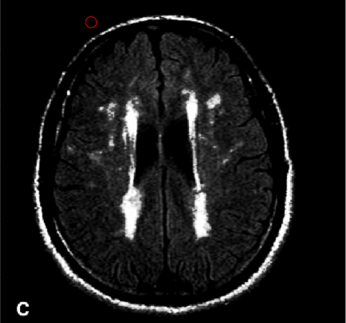
Gradient Based Level Set – Real World Application

Slide 21
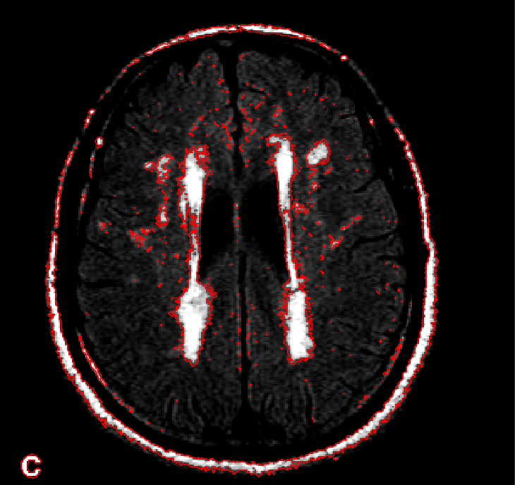
Gradient Based Level Set – Real World Application
Lax Friedrich Flux eventually leads to numerical errors that do not dissipate

Slide 22
Conclusions
Both gradient method and region based methods lead to good segmentation. Both options work depending on application, though the second is the necessary choice if automation is desired
Schemes are relatively straightforward and with proper preprocessing, we can create flexible segmentation algorithms
While my schemes are reliant on initial parameters, these decisions can be automated

Slide 23
Improvements
Preprocessing!!
2nd Order Schemes:
Both Upwind and Lax Friedrichs Flux schemes have higher order variants
Weighted Essentially Non Oscillatory (WENO) schemes instead of Lax Friedrichs Flux would fix oscillation issue
Level Set methods are a great way to avoid problems existing in explicit front propagation BUT the main drawback is memory and speed.
Must define entire surface and evolve entire surface each time, instead of just contour

Slide 24
Bibliography
Lombaert, Herve. "Level Set Method: Explanation." Level Set Method: An Explanation. https://profs.etsmtl.ca/hlombaert/levelset/.
Chen, Tenn F. “Medical Image Segmentation using Level Sets.”
Sethian, J.A. “Theory, Algorithms, and Applications of Level Set Methods for Propogating Surfaces.” Acta Numerica.
Stanley, Osher. Fedkiw, Ronald P. “Level Set Methods: An Overview and Some Recent Results.”
Tadmor, Eitan. “A Review of Numerical Methods for Nonlinear Partial Differential Equations.” Bulletin Of The American Mathematical Society.

Slide 25
Image sources
https://profs.etsmtl.ca/hlombaert/levelset/
https://profs.etsmtl.ca/hlombaert/region/
https://link.springer.com/content/pdf/10.1007/s11263-006-8711-1.pdf
https://en.wikipedia.org/wiki/Level-set_method
http://brainposts.blogspot.com/2011/10/brain-white-matter-changes-increase.html

